Slide 1

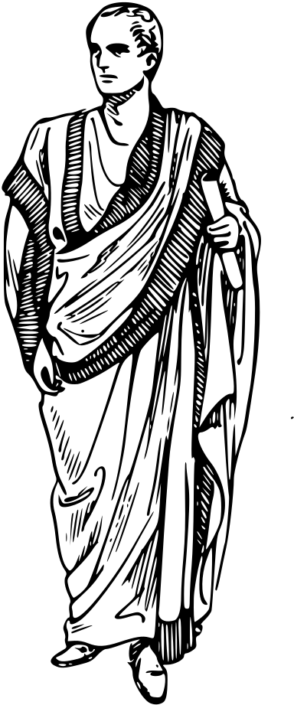


UNIT: 2
BIOGRAPHIES
What makes a life worth writing about?

Slide 2
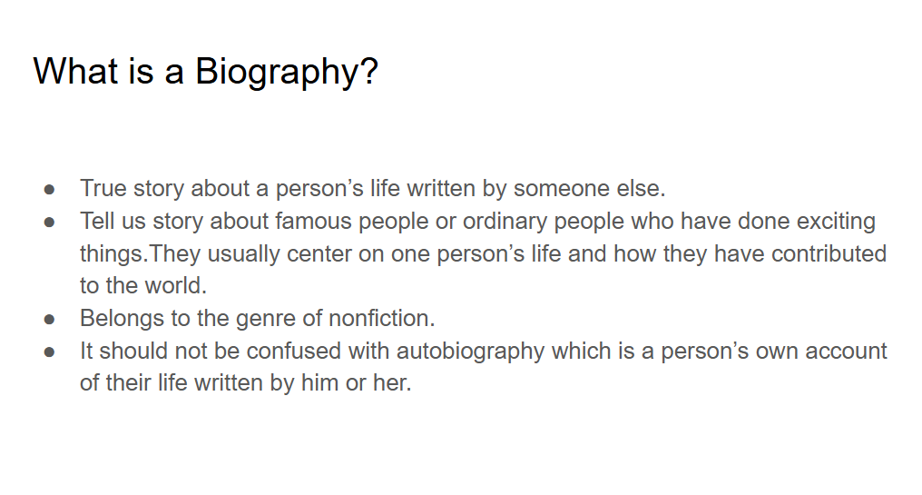


Modelling:

Slide 3
PERSON | What they are famous for? | Biography Title
Helen keller | First person with deafblindness to earn a college degree. | The Story of My Life
Dr. Suess | Children’s author | Becoming Dr. Suess
Christopher Columbus | A famous explorer | Across the Ocean Sea
Martin Luther King | Civil Rights Leader | Martin Luther King, Jr.: A Life
Malala yousafzai | Child rights activist - Women’s right to education | I am Malala
Usain Bolt | Fastest Runner | The fastest Man Alive - The true Story of Usain Bolt
Dr Abdul Kalam Azad | Scientist | Wings of Fire

Slide 4
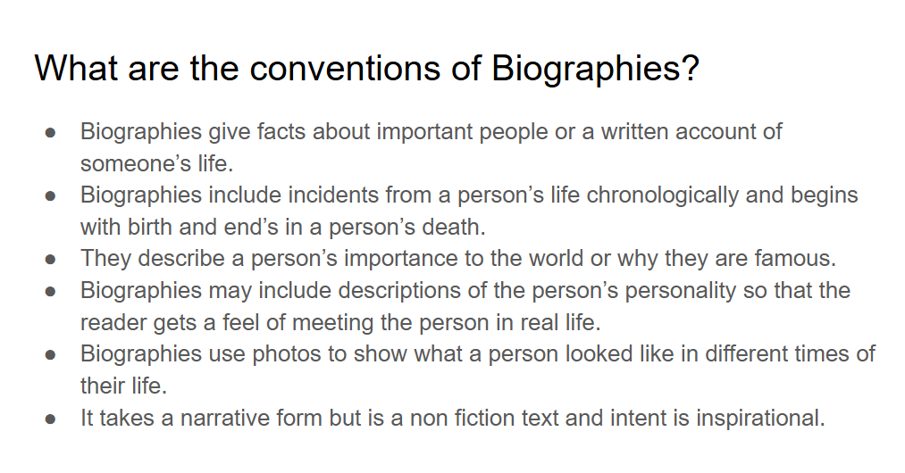

Slide 5
Unit: What makes a life worth writing about?
Learning objective: To read in groups and analyze the text to identify the conventions of a biography.
Group activity - write the given questions in your journals.Read the text (in the link below) as a group, analyse the text, discuss the answers and write the answers in your journals.
What information is provided here? What do they add to the biography?
Why have these key events been included? What impact do they have on the readers?
What do we learn about his achievements?
Why does Abdi deserve a biography?
Comment on the structure of the biography.
Link for the Text: https://docs.google.com/document/d/18Ia2tv3r55IVA22uPAT2jFWnPZdu_ARV/edit?usp=drive_link&ouid=112926585890473367957&rtpof=true&sd=true

Slide 6
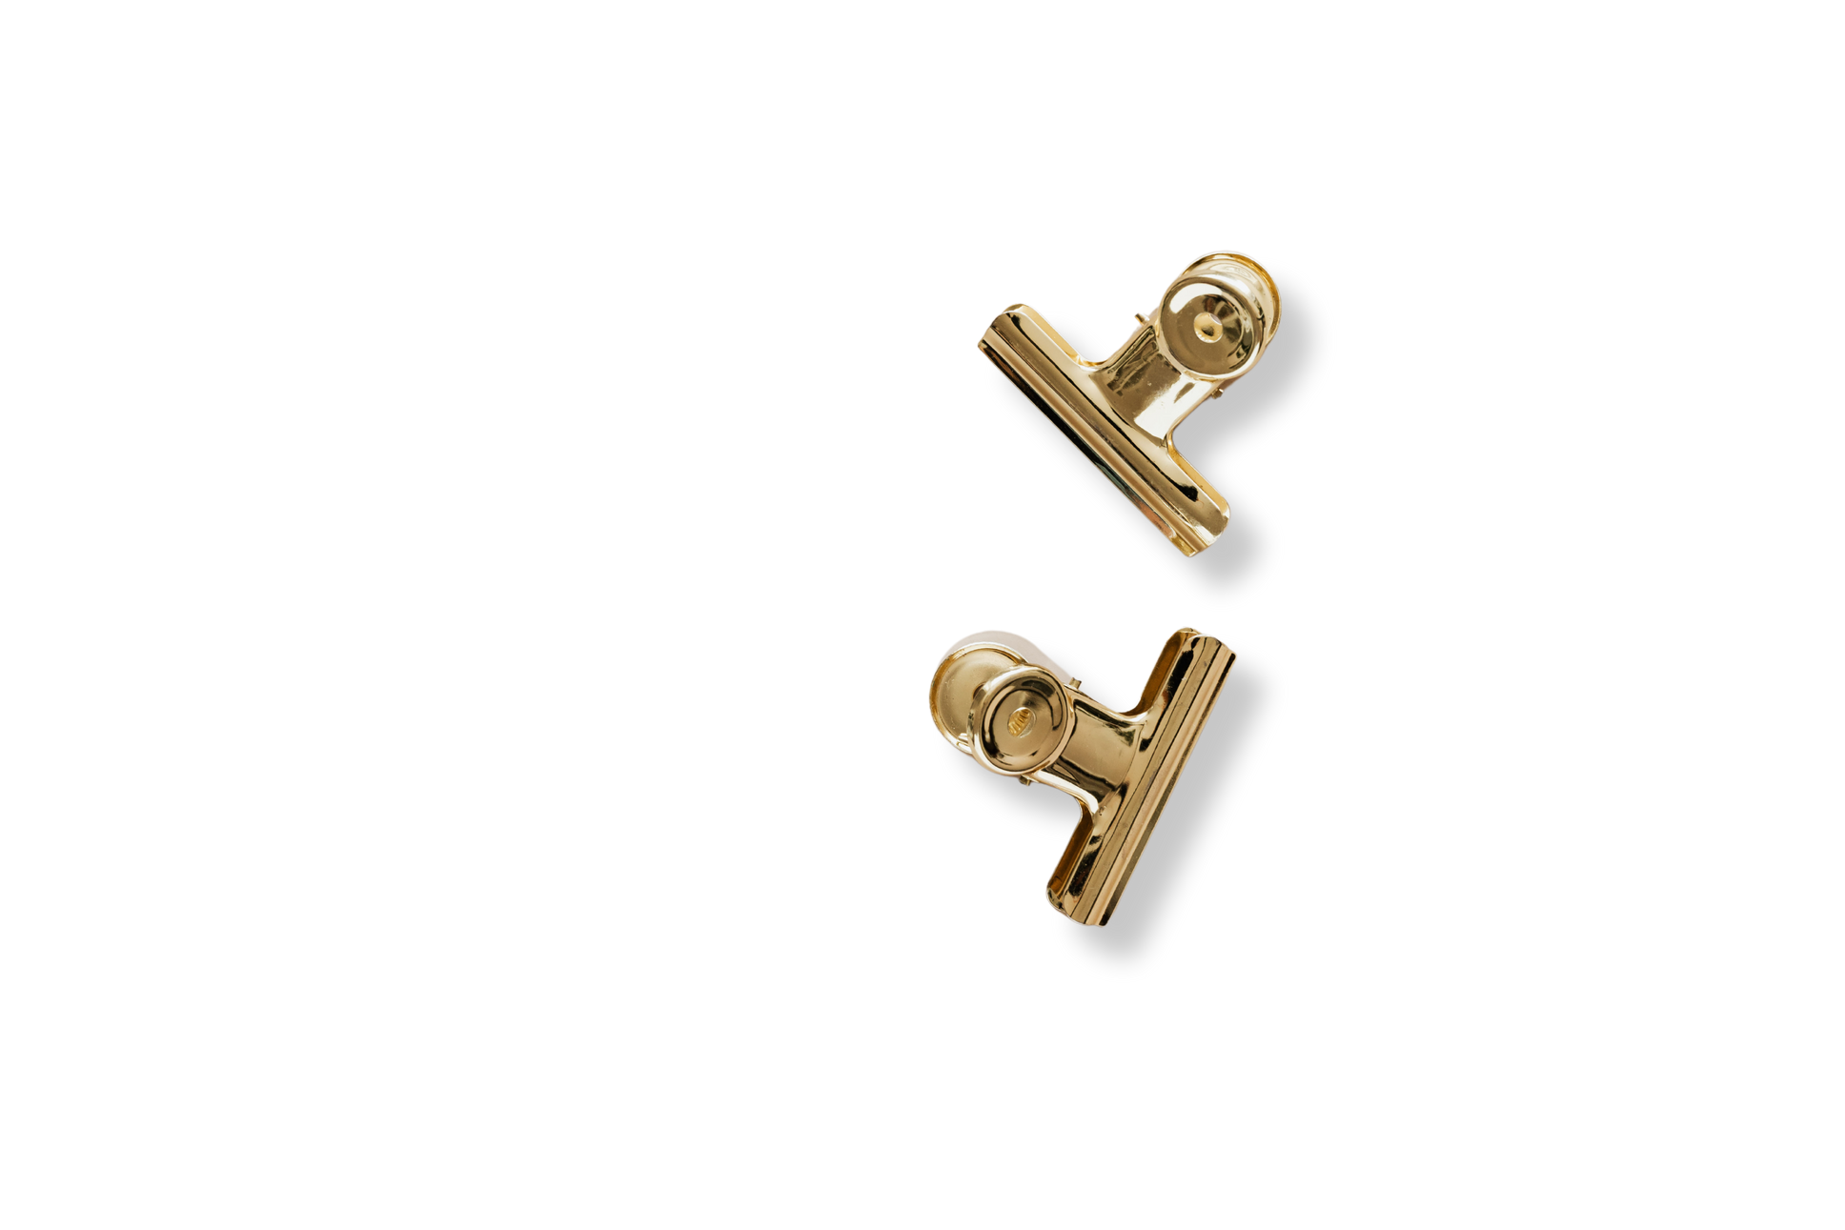


LEARNING EXTENSION
Biography
Refer to the Drive to complete the Biography Learning extension.
For teacher’s reference: https://docs.google.com/document/d/1rr9461s693GhbgJRq69PJBT4ZPqTo6VN/edit?usp=drive_link&ouid=112926585890473367957&rtpof=true&sd=true

Slide 7

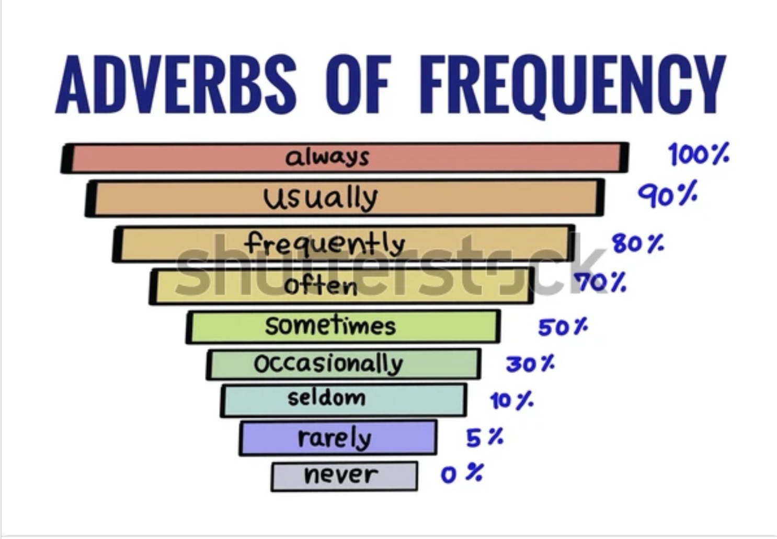

Slide 8
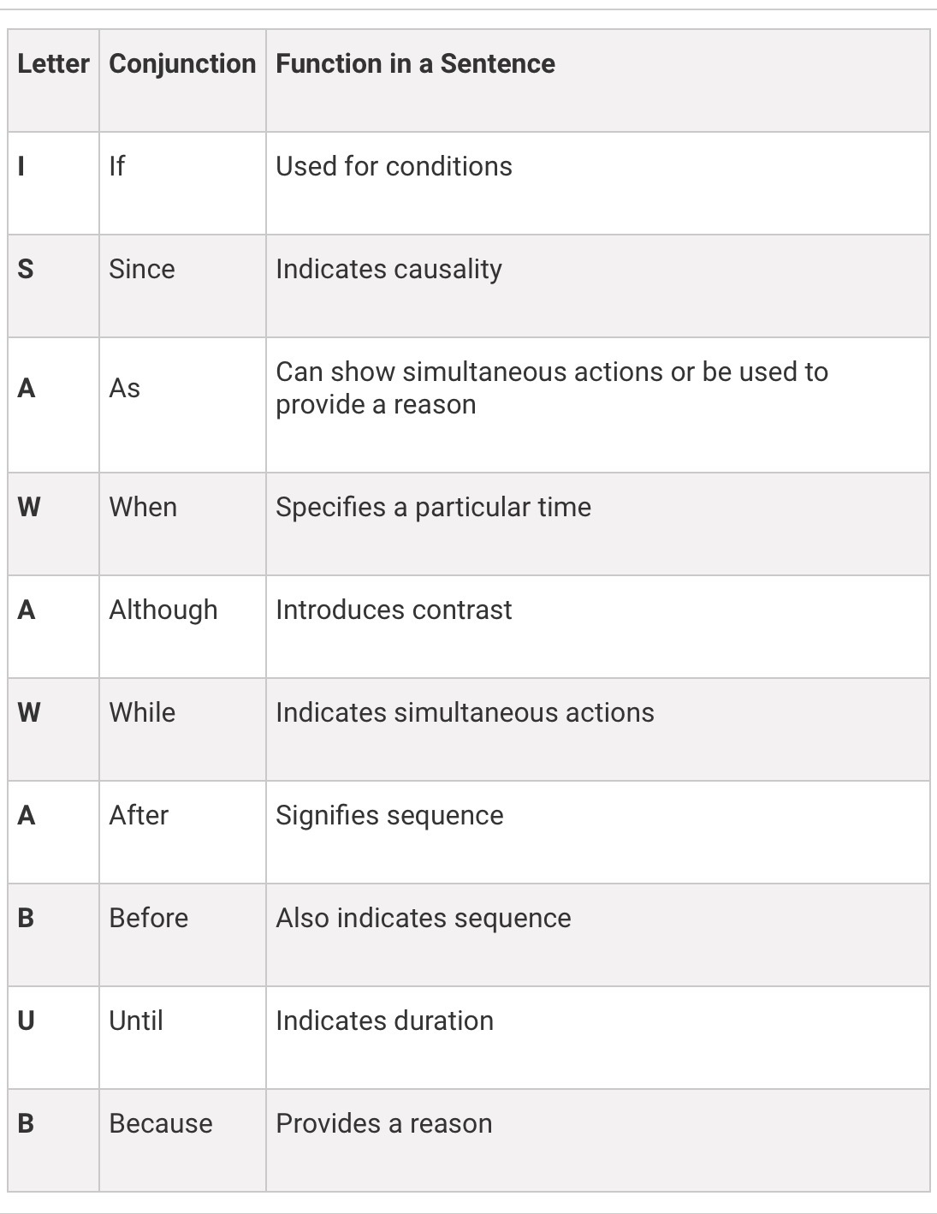

Slide 9


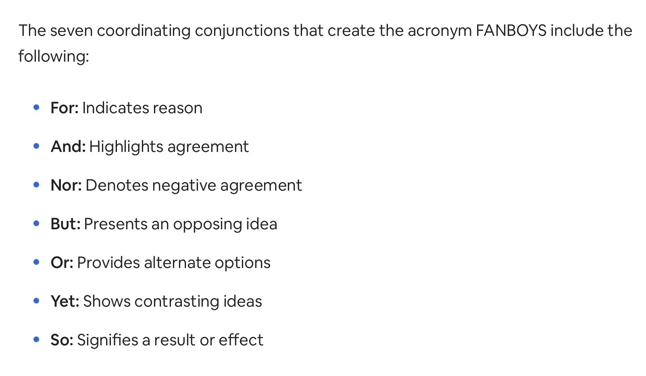
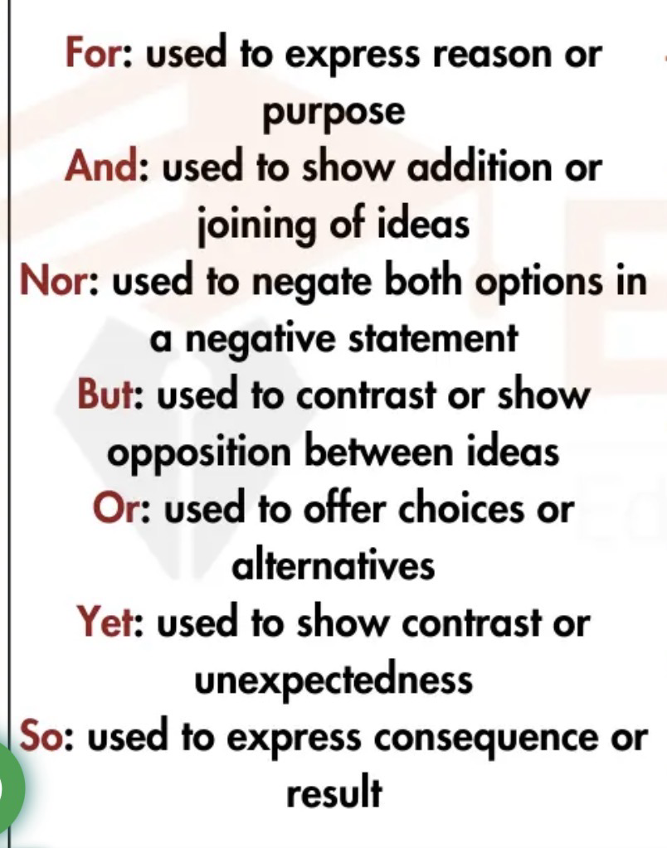

Slide 10
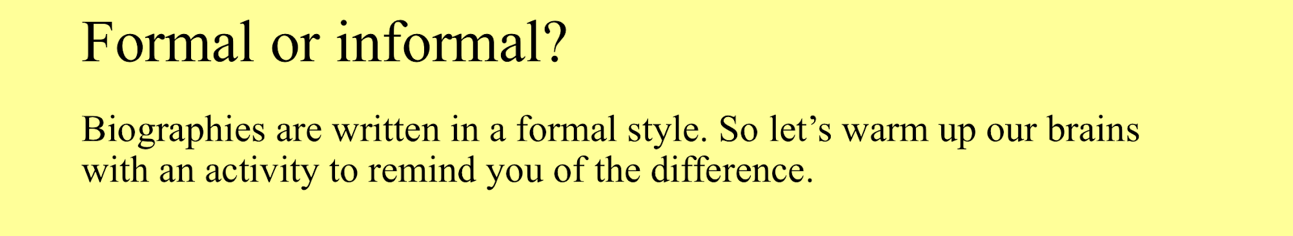
Day 3
Revision on Formal and Informal English Language
To be copied in the journals.

Slide 11
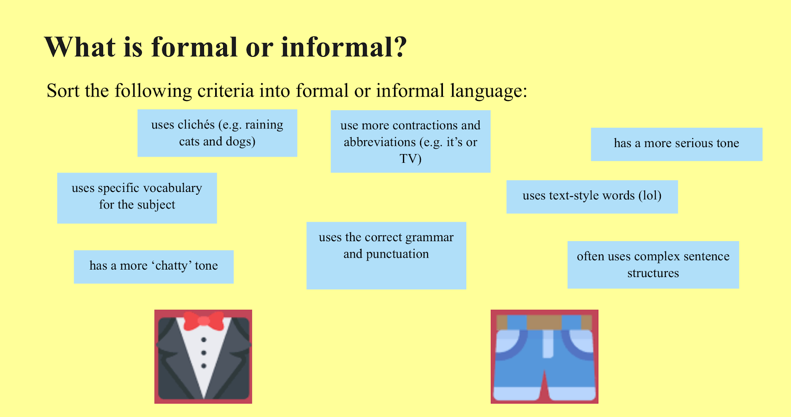

Slide 12
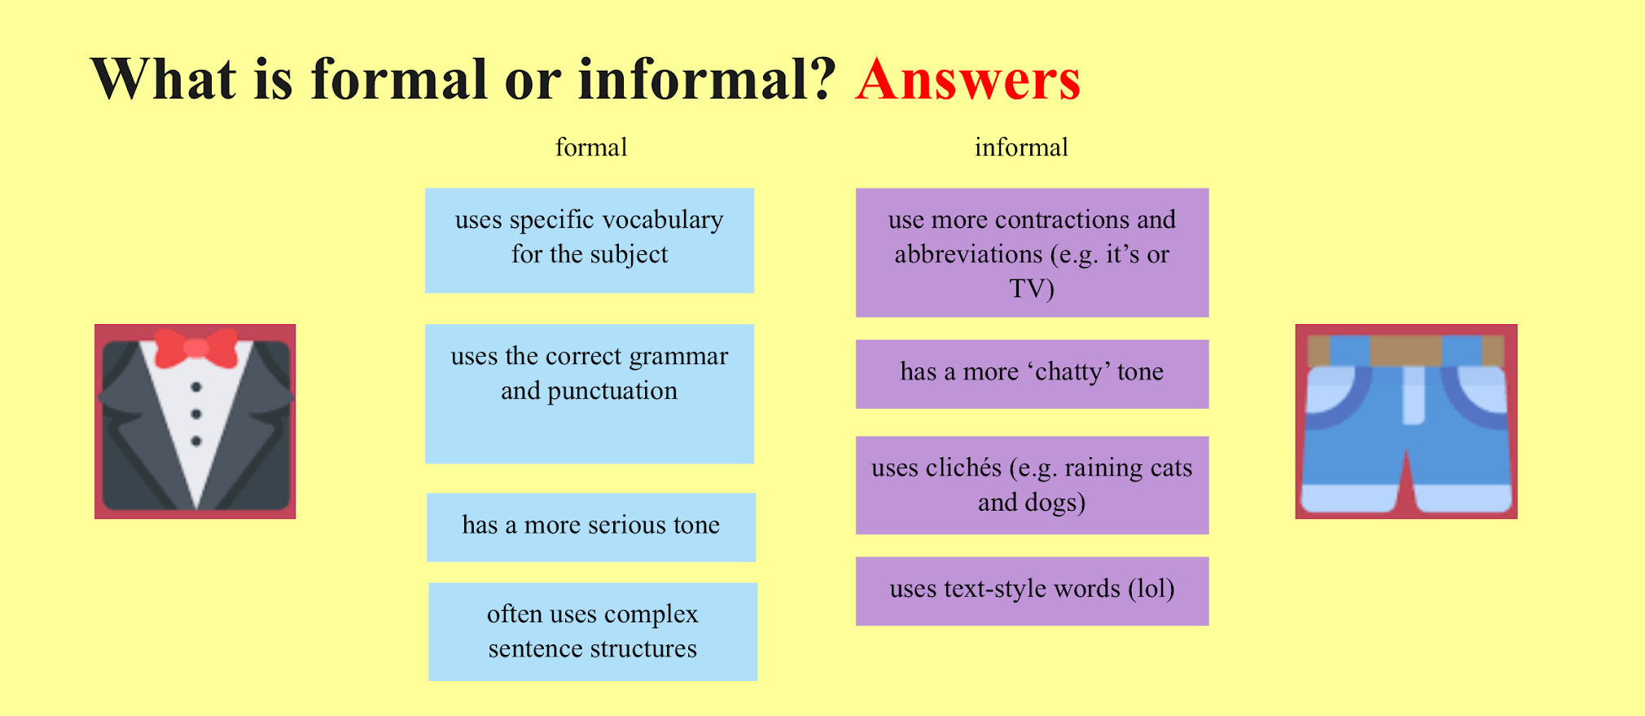

Slide 13
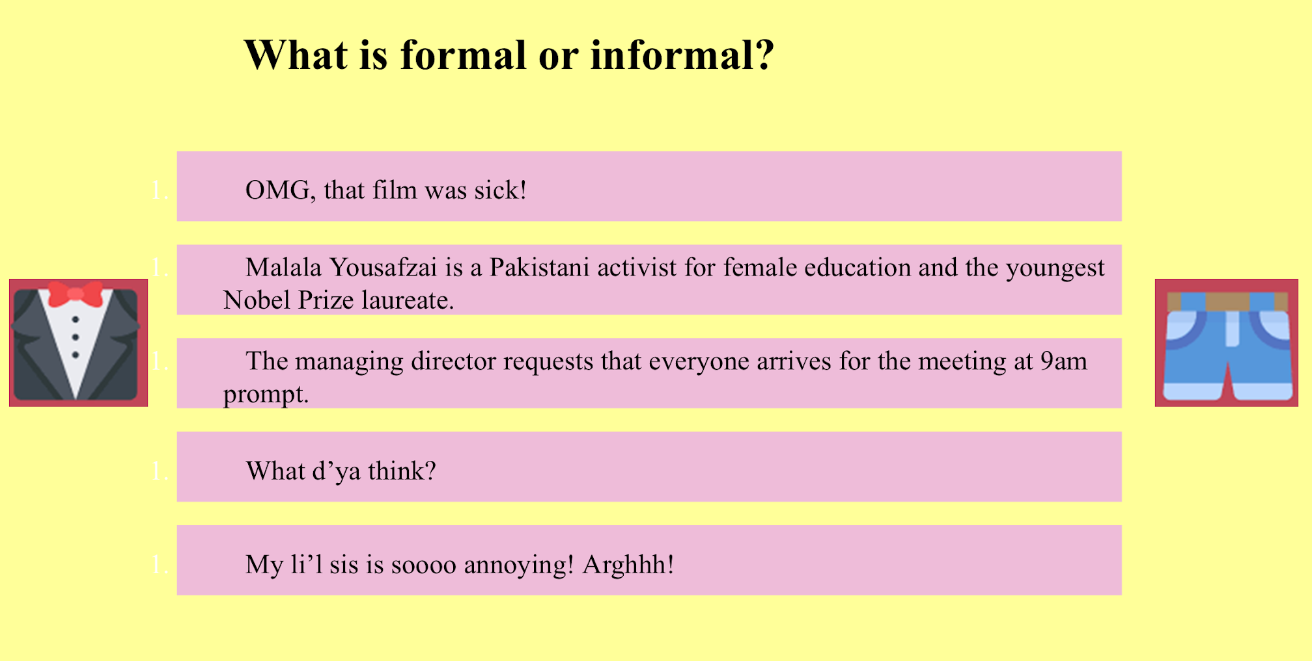

Slide 14
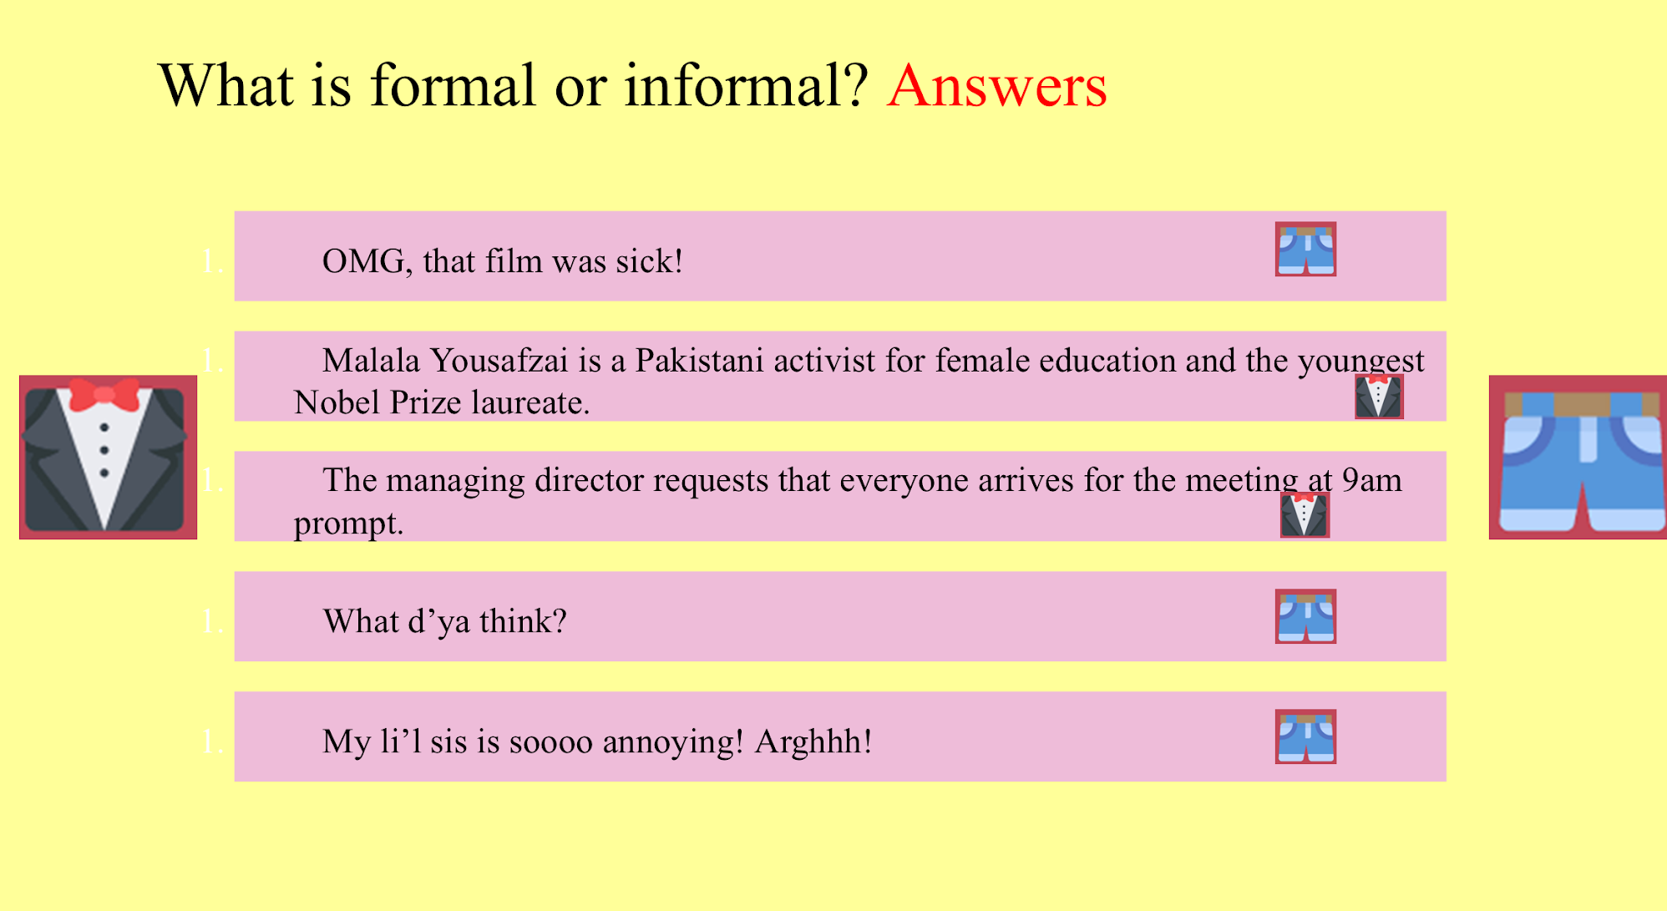

Slide 15
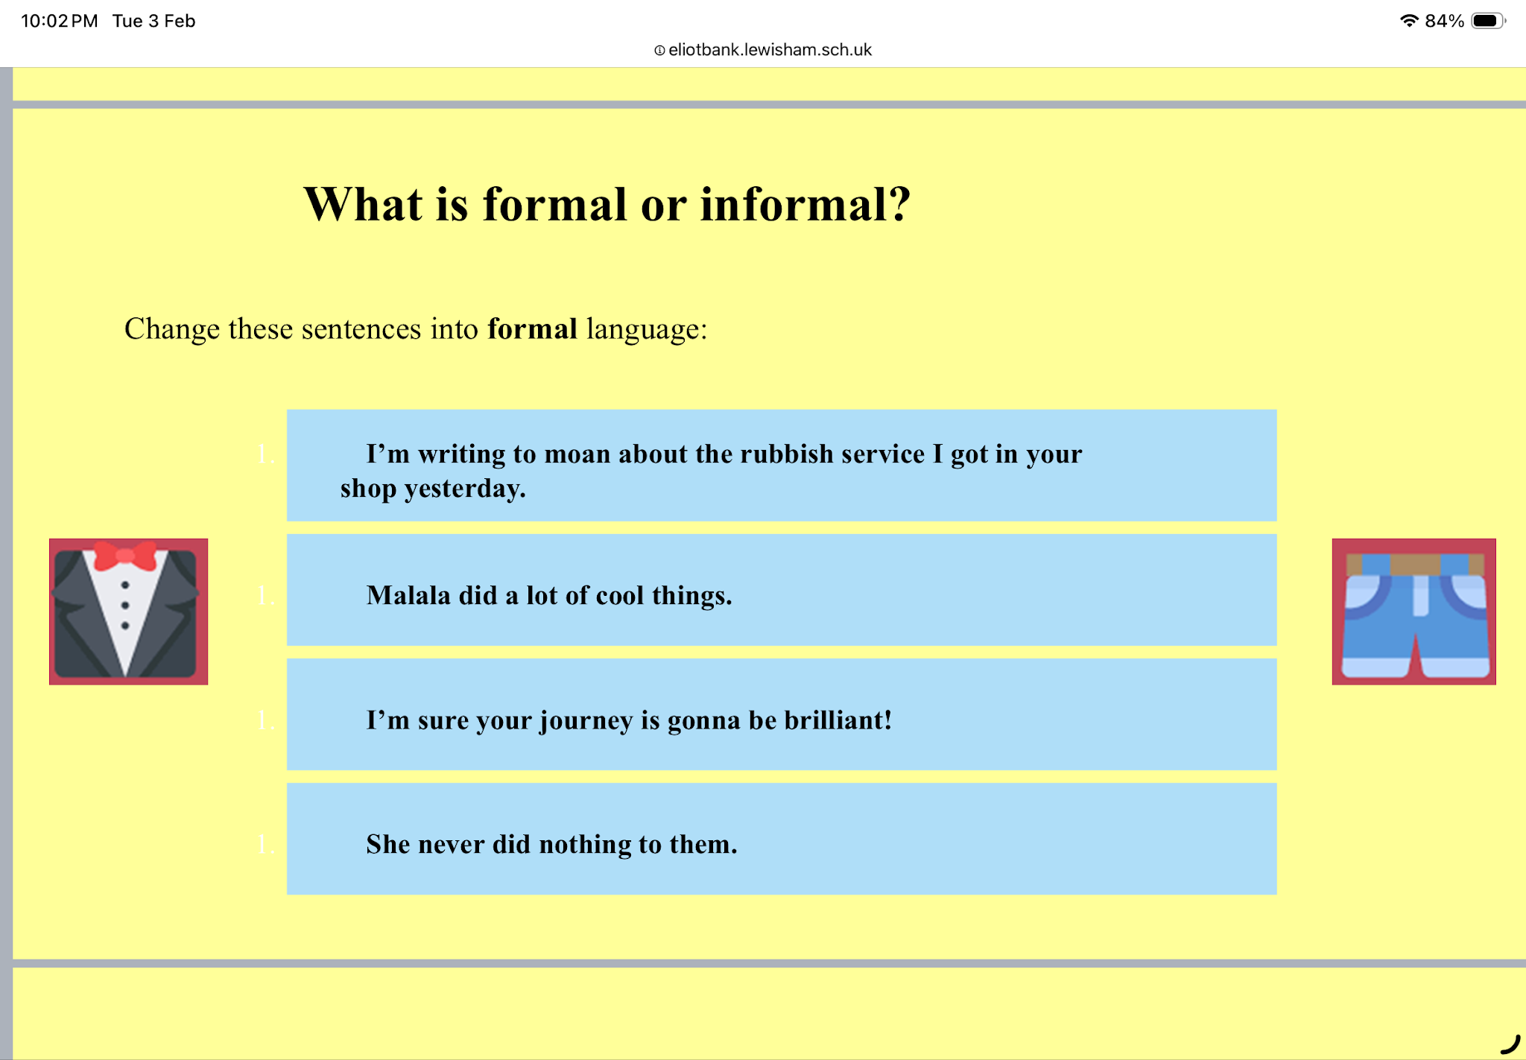

Slide 16
Answers
1. Malala has made many meaningful contributions.
1. Malala accomplished numerous significant achievements.
1. Malala has achieved a great deal through her work.
2. I am confident that your journey will be remarkable.
2. I am confident that your journey will be a rewarding one.
2. I believe your journey will be both successful and fulfilling.
3. She did nothing to harm them.
3. She never caused them any harm.
3. She took no action against them.

Slide 17
Simple, Compound, and Complex Sentences
Link : https://yout-u.be/smgyeUomfyA
Compound-Complex Sentences
Link: https://yout-u.be/eN2NMvUrtP0?si=tJRFgr6bdUiaD6l_

Slide 18
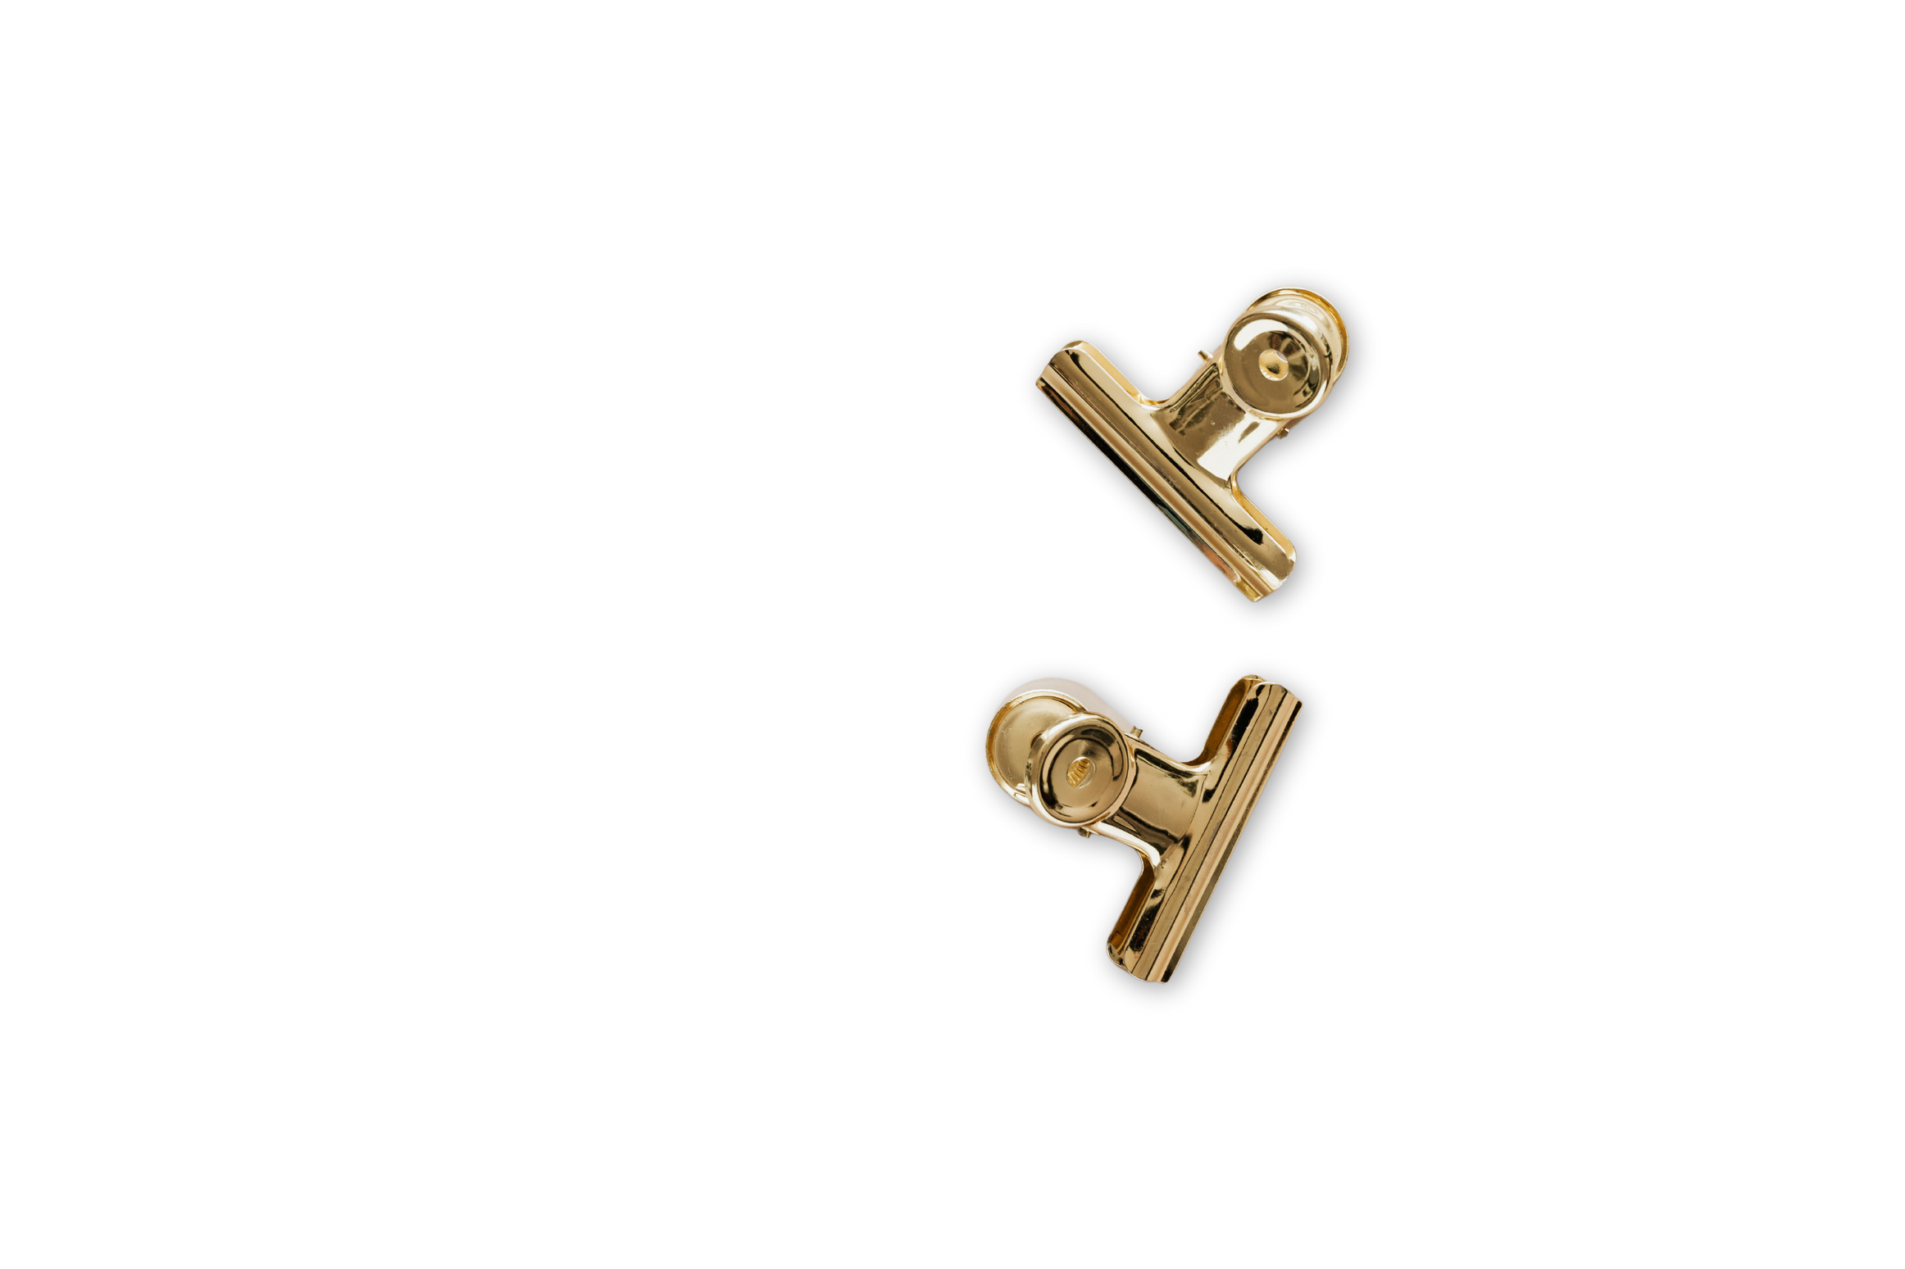

THANK YOU

